Slide 1
Welcome to the Eaglelite Book Club

Slide 2
Meeting Plan
Welcome -Moderator
Introductions (optional)
About the Book Club
Book review- 40mins (20 each)
Reflections and reactions (20mins)
About Eaglelite Associates

Slide 3
About the Book Club
Will be part of a team that will be supported to improve their reading culture through peer mentorship
Gain access and membership to our library partner who has access to wider range of books (future)
Get opportunities to lead book reviews or share learnings with the larger network of people from various professions
Have guaranteed slots in organized book review meetings with associated benefits
Deep dive sessions where dig deeper into the book.
Will be meeting every last Saturday of every month

Slide 4
Author:
Michael Hyatt
Reviewer:
Brenda Abeja
Co-founder, Eaglelite Associates

Slide 5
Introduction
“…most of us have a long history of not getting what we want out of life. To shield ourselves from future disappointment, we develop a cynical, self-protective attitude toward life.”…
“We’ve tried to step out in the past and been zapped—or far worse. Maybe it was only once. Or maybe it was several times. Regardless, now we stand still even when there is no actual barrier. The one in our heads is strong enough to keep us stuck.”

Slide 6
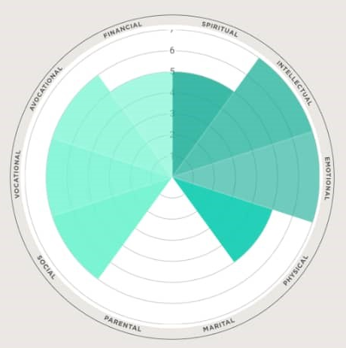
http://bestyearever.me/lifescore

Slide 7
01
Believe the Possibility

Slide 8
Step 1: BELIEVE the POSSIBILITY
Your Beliefs Shape Your Reality. What happens is of little significance compared with the stories we tell ourselves about what happens. RABIH ALAMEDDINE, The Hakawati
Our beliefs play a massive part in how we approach life.
We tend to experience what we expect.
One of the biggest reasons we don’t succeed with our goals is we doubt we can. We believe they’re out of reach.

Slide 9
Read along
You know what this looks like. You say, “I need to apply for that new job.” But then you think, “There’s no way. I don’t have enough experience or enough education.” Suddenly, an idea that might take you to the next chapter of your story just withers and dies.
Or maybe a friend says, “Hey, you and Bill should go to that marriage retreat this weekend.” And you think, “Are you kidding me? I can’t get him off the couch for an evening, let alone a whole weekend.”
Or somebody says, “I think it would be awesome to run a 5K.” And you think, “Maybe I should.” But then the cynicism sets in. “I’m forty pounds overweight,” you think. “I’ve got a bum knee. There’s no way I could possibly run a 5K.”
It’s hard to get your hopes dashed if you never get them up to begin with. But that kind of cynicism poisons our souls and sabotages our results. Our beliefs about what’s possible have a direct impact on the reality we experience.

Slide 10
Notes:
ABOUT THE WORLD
ABOUT OTHERS
ABOUT OURSELVES
We might say, “I’m a quitter. I never finish what I start.” Or, “I can’t help it. I’ve never been physically fit.” Or, “I’ve always been terrible with money.” Or, “I’m just not the creative type.” These beliefs are often false or half-truths at best. And they will roadblock any progress you want to make in life.

Slide 11
Black-and-white thinking
Personalizing
That’s when we assume we’ve failed if we don’t achieve perfection. Reality is usually a sliding scale, not a toggle switch.
That’s when we blame ourselves for random negative occurrences.
Catastrophizing
Universalizing
That’s when we assume the worst even with little evidence.
That’s when we take a bad experience and assume it’s true across the board.

Slide 12
About Beliefs
You Can Upgrade Your Beliefs
Your Beliefs Shape Your Reality. What happens is of little significance compared with the stories we tell ourselves about what happens. Rabih Alameddine, The Hakawati
Some Beliefs Hold You Back. How little we see! What we do see depends mainly on what we look for. Sir John Lubbock, The Beauties of Nature
You Can Upgrade Your Beliefs. Impossible is not a fact. It’s an opinion. Muhammad Ali
Avoiding the Trap of Limiting Beliefs
Trade Your Frame
Revise Your Beliefs
What Are Your Limiting Beliefs?

Slide 13
While limiting beliefs prevent us from overcoming them, liberating truths help us transcend obstacles and improve our circumstances.
Notes:
Recognize the Power of Your Beliefs
Confront Your Limiting Beliefs
Upgrade Your Beliefs

Slide 14
Step 1 Wrap Up
1. Recognize the Power of Your Beliefs: “Our thoughts determine our lives,” as the Serbian monk Thaddeus of Vitovnica said. Both positively and negatively, your beliefs have tremendous impact on your experience of life. Recognizing that fact is the first stage in experiencing your best year ever.
2. Confront Your Limiting Beliefs: We all have limiting beliefs about the world, others, and ourselves. Four indicators you’re trapped in a limiting belief are whether your opinion is formed by:
‣ Black-and-white thinking ‣ Personalizing ‣ Catastrophizing ‣ Universalizing.
It’s also important to identify the source of your limiting beliefs, whether it’s past experience, the news media, social media, or negative relationships.

Slide 15
3. Upgrade Your Beliefs. Get a notebook or a pad of paper and draw a line down the middle of the page so you have two columns. Now use this six-step process to swap your limiting beliefs for liberating truths.
‣ RECOGNIZE your limiting belief. Upgrading your thinking starts with awareness, so take a minute to reflect on what beliefs are holding you back.
‣ RECORD the belief. In the left-hand column, jot down the belief. Writing it down helps you externalize it.
‣ REVIEW the belief. Evaluate how the belief is serving you. Is it empowering? Is it helping you reach your goals?
‣ REJECT/REFRAME the belief. Sometimes you can simply contradict a limiting belief. Other times, you might need to build a case against it or look at your obstacles from a better angle.
‣ REVISE the belief. In the right-hand column write down a new liberating truth that corresponds to the old limiting belief.
‣ REORIENT yourself to the new belief. Commit to living as if it’s true.

Slide 16
02
Complete the Past
Thinking Backward Is a Must
Regret Reveals Opportunity
Gratitude Makes the Difference
Action Plan

Slide 17
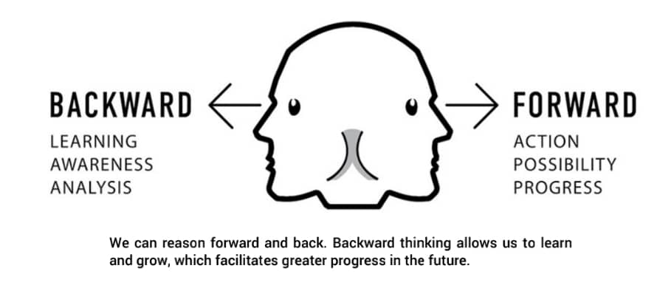
Thinking Backward Is a Must. We drive into the future using only our rear-view mirror. - Marshall Mcluhan

Slide 18
The After-Action Review.
First developed in 1981, America’s armed forces have been using it ever since to improve performance and get better at what they do. After an event, the goal is to understand what happened, why it happened, and how they can improve.
Stage 1: State What You Wanted to Happen
Stage 2: Acknowledge What Actually Happened
Stage 3: Learn from the Experience
Stage 4: Adjust Your Behavior
Notes:
Let me go back to the story that started the chapter. When my client fired me on the verge of our biggest deal to date, it floored me. I thought I had done a great job. Besides, we had enjoyed a long-term personal relationship. I worked my tail off for about a year, focusing exclusively on this one client. But my client wasn’t so impressed. He had his eye on bigger things and decided I couldn’t take him there. So, without so much as a discussion, he dumped me. In the end it was a humbling but helpful experience. I learned three important lessons. First, clients (and customers) can be fickle. I couldn’t afford to put all my eggs in one basket. If I didn’t spread the risk, I might find myself in serious trouble again. Second, I learned I couldn’t assume today’s victories would be remembered or appreciated. I had to keep raising the bar. Finally, I learned I needed to secure alignment from all the relevant parties up front. It turned out my client and his board had different ideas about what I was delivering. All three lessons have been invaluable over the years.

Slide 19
Regret Reveals Opportunity
My new rule: “whenever things go wrong, wait and see what better thing is coming.” SCOTT CAIRNS, Short Trip to the Edge
“Regrets not only goad us toward corrective behavior, studies show we also tend to feel regret the strongest when the opportunity for improvement is at its greatest.”
Notes:
When the regret bomb blew up in my life, I was able to reevaluate and reorient my priorities. Restoring my most important relationships was hard work, but without regret it would have been impossible. I would have been oblivious to the need or resentful that others weren’t pulling their weight. Regret forced me to own my part in the failure and correct it, and the relationship with my daughters has never been better than it is today.

Slide 20
Gratitude Makes the Difference. It is only with gratitude that life becomes rich.
Dietrich Bonhoeffer

Slide 21
Regardless of our individual circumstances, we all can point to assets, blessings, and gifts in our lives. Yes, there are a million things we don’t have. But there are a million we do. Whatever our past, if we can see it through the lens of gratitude we will discover that our present is full of more than we can possibly ask or imagine
I start and end the day with prayer. Instead of bookending the day with what I failed to get—sleep or accomplishments or whatever—I try focusing on the blessings I do have and expressing them in prayer.
I practice thankfulness. Before I get caught in endless comparisons, I express gratitude for the gifts I do have. I find prayer before meals gives me several natural points in the day to do this.
I journal my gratitude. Journaling is useful for many things but expressing and capturing our gratitude is certainly one.

Slide 22
Step 2: Wrap up
Conduct an After-Action Review
Find the Opportunity Hidden in Regret
Try Gratitude Exercises

Slide 23
03
Design Your Future

Slide 24
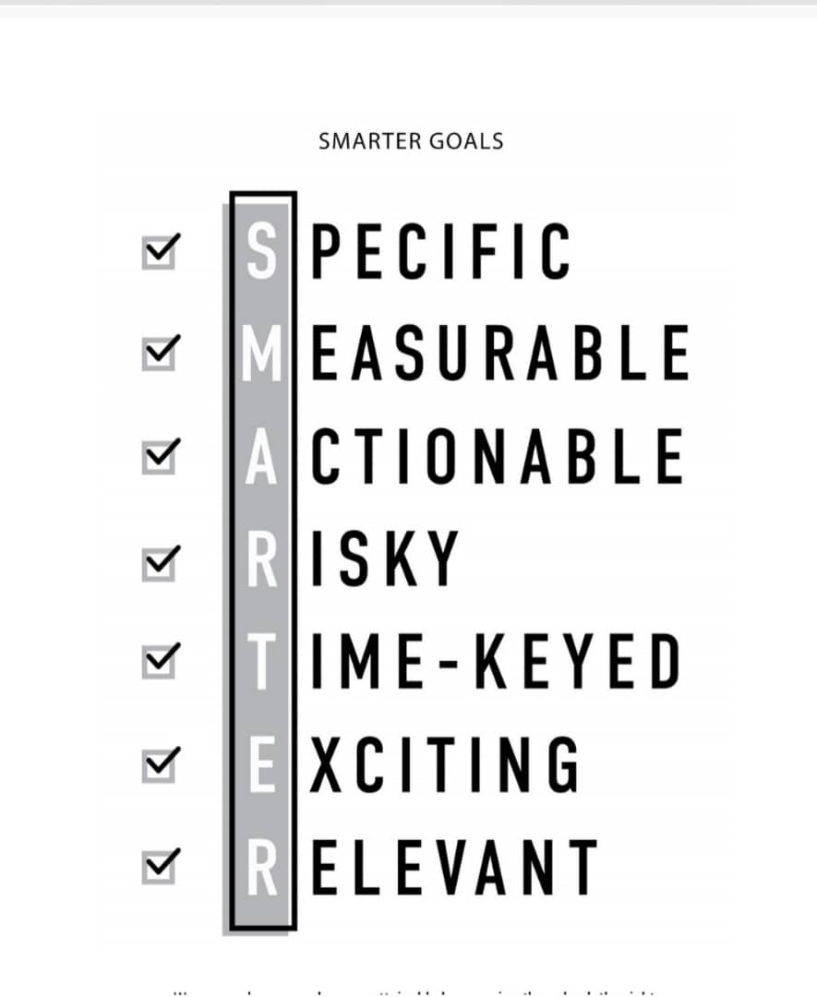
Step 3: DESIGN YOUR FUTURE
Great Goals Check Seven Boxes. Do not think or do anything without having some aim in sight; the person who journeys aimlessly will have labored in vain.
- Mark the Monk
Notes:
A couple of examples: “Be more consistent in blogging.” Is that actionable? No. That’s a state-of-being verb. But something like “Write two blog posts a week,” that’s Actionable. It starts with the verb write, and it’s clear and directive about the action. Here’s another example: “Be more health conscious.” Is that actionable? Not really. Instead you could say something like “Walk for thirty minutes five times a week.”

Slide 25
Achievements and Habits Work Together. The reason most people never reach their goals is that they don’t define them.
- Denis Watley
Achievement Goals
Habit Goals
Achievement goals are focused on one-time accomplishments. They might target paying off your credit cards, hitting a financial benchmark, or finishing writing a novel. It’s essential that achievement goals include deadlines.
Habit goals, on the other hand, involve regular, ongoing activity, such as a daily meditation practice, a monthly coffee date with a friend, or walking each day after lunch. There’s no deadline because you’re not trying to accomplish just one thing. You’re trying to maintain a practice. Instead, there’s a start date, which triggers initiation.
(Start date, Time trigger, Streak target )

Slide 30
Step 3: Wrap up
Set Your Goals
Decide on the Right Mix of Achievements and Habits
Set Goals in the Discomfort Zone

Slide 31
04
Find Your Why

Slide 32
Step 4: FIND YOUR WHY
In his book A Million Miles in a Thousand Years, Donald Miller talks about crossing a stretch of water—not just leaving shore and arriving at the other side, but also “the hard work of the middle.” It’s a metaphor for anything meaningful we undertake. Pushing off gives us the rush of anticipation and progress. But the anticipation fades and the progress seems to slow. Pretty soon we’re in the messy middle, doubting if we have the strength to make it to the other side—or maybe why we started in the first place.

Slide 33
Your What Needs a Why.
The Myth of Fun, Fast, and Easy
Identify Your Key Motivations
Record and Prioritize Your Key Motivations
Connect with Your Key Motivations
What’s at Stake for You?
Be Realistic about the Commitment
If you really want to do something, you will work hard for it.
Sir Edmund Hillary

Slide 34
The journey is better with friends

Slide 35
Step 4: Wrap up
Connect with Your Why
Master Your Motivation
Build Your Team

Slide 36
04
Make it Happen

Slide 37
Step 5: MAKE IT HAPPEN
One Journey Is Many Steps. The great doesn’t happen through impulse alone and is a succession of little things that are brought together. VINCENT VAN GOGH, from a letter to his brother Theo
The Art of the Start
Do the Easiest Task First
Seek Outside Help
Commit to Act
You Can Trigger Success. (Timers, alarms, alerts, pre-orders)pg157
Anticipate Obstacles and Determine Your Response
Experiment until You Nail It
The Other Half of the Job (“If I do my full duty, the rest will take care of itself.”)
Notes:
If passion drives you, let reason hold the reins. BENJAMIN FRANKLIN

Slide 38
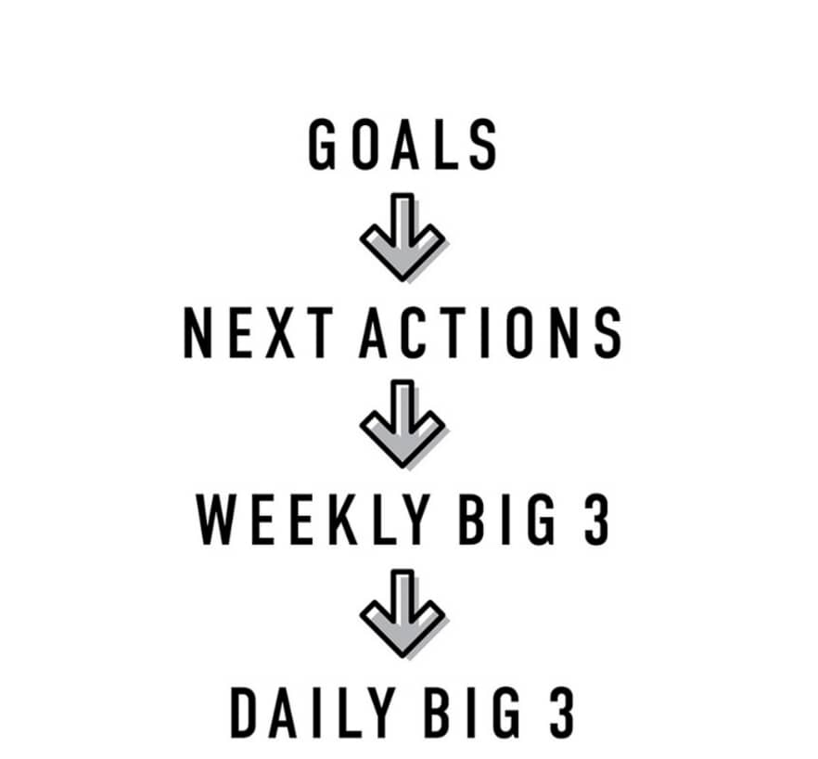
Visibility Is Essential. It is good to repeat and review what is good twice and thrice over.
- Plato, Gorgias

Slide 39
Quarterly Review

Slide 40
Step 5: Wrap up
Break Down Big Goals into Manageable Next Steps
Utilize Activation Triggers
Schedule Regular Goal Reviews

Slide 41
Who we are:
For more information:
Tel: +25677309970 (Allan) or +256781567693 (Brenda)
Email: eagleliteassociates@gmail.com
We are a leadership consultancy and performance coaching and management company.
We work with organizations and individuals; empowering them to improve their effectiveness at work and in their work.
We partner with and empower professionals in a range of areas to enable positive change to occur. We are building a movement of professionals determined to promote a culture of effectiveness and excellence in their areas of influence.

Slide 42
Led several leadership development programs, change initiatives, strategic projects and performance improvement and coaching programs with a growing list of leading national and international institutions from different sectors:
International Institutions:
Government Institutions & Universities:
Non-profits & Churches:
For Profit Organizations:

Slide 43
How can we partner with you?
Organizational Capacity Building:
We conduct organizational operational & capacity assessments and work with your team to improve your effectiveness.
Book Clubs & Mastermind Classes:
We work with you and your team to study a book or books that can empower you to become more effective.
Personal/Group Development Coaching:
We work with individual or groups of people through various aspects of their lives and help them win at work.

