Slide 1
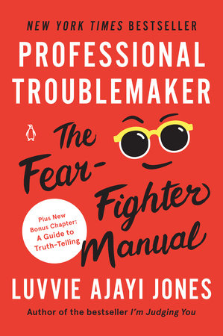
BOOK REVIEW
Reviewer: Brenda Abeja
Date: September 2nd 2022
Where: CI-UG Book Club

Slide 2
Professional Troublemaker
I wanted to know what troublemaking was about
I have my own fears that I constantly deal with- I needed encouragement
This is also a book I need now; in the times I am not feeling so bold. It is a book from me to me that I am letting other people read. I still need the prompts. I still need to remind myself to deal with the scary stuff I’m compelled to do and deal with how it falls –Luvvie
I have friends who need to be reminded and encouraged😘

Slide 3
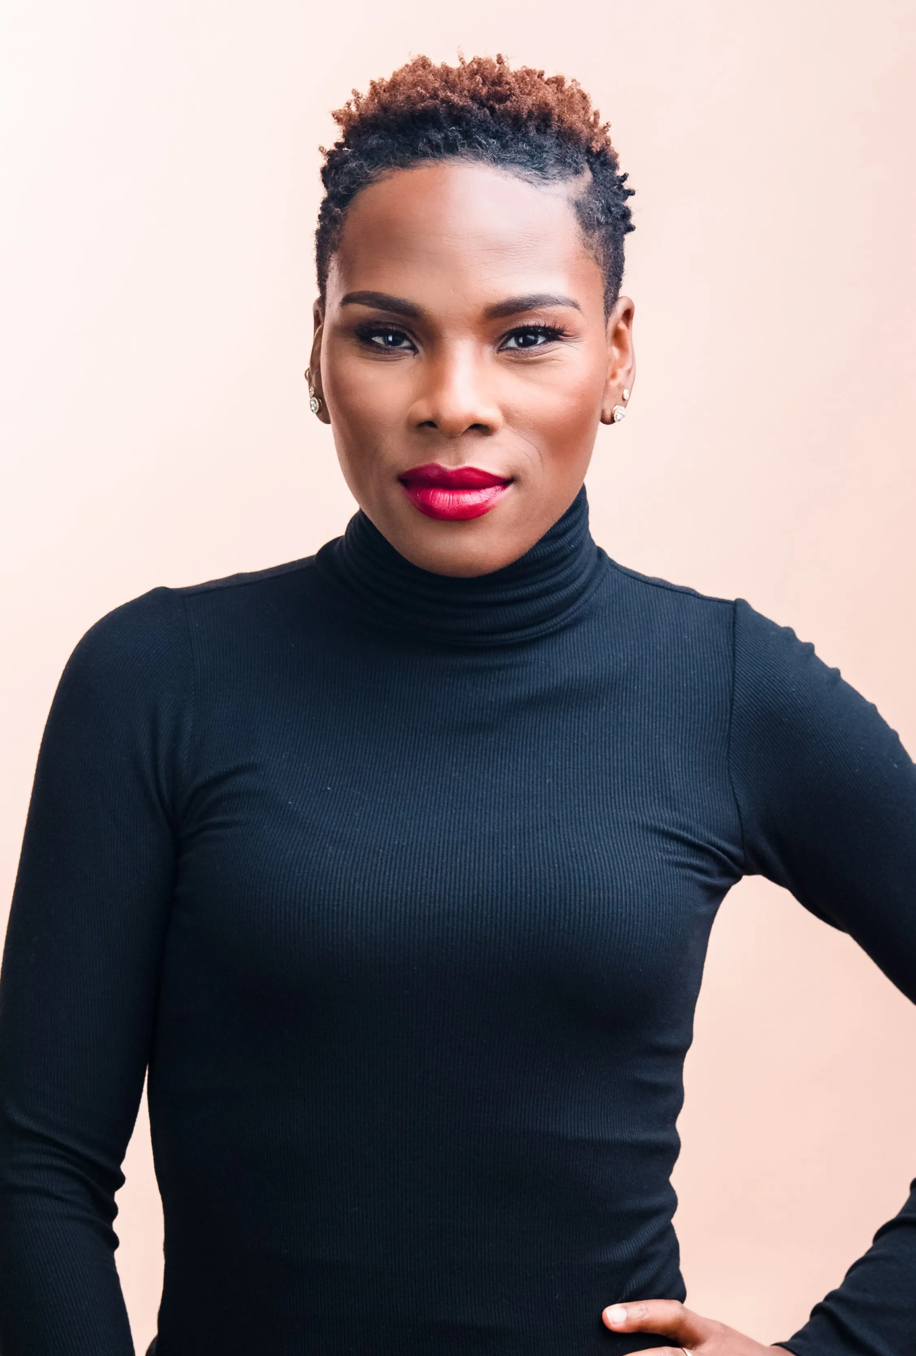
About Luvvie
“There’s nobody quite like Luvvie. She’s a force and a powerhouse, the thunder and lightning …and the book shows us just how she got that way. In a voice that is funny, wise, bold, and always generous, Luvvie encourages, inspires and dares us to take up all the space.” Elizabeth Gilbert, New York Times best selling author of Eat Pray Love
Luvvie Ajayi Jones is a three-time New York Times bestselling author, speaker and podcast host who thrives at the intersection of humor, media, and justice.
Her critically acclaimed books Professional Troublemaker: The Fear-Fighter Manual (2021), Rising Troublemaker: A Fear-Fighter Manual for Teens (2022) and I’m Judging You: The Do-Better Manual (2016) were instant bestsellers and established her as a literary force with a powerful pen.

Slide 4
BOOK CHAPTERS
BE
SAY
DO
Grow wildly
Fire yourself
Take no s**t
Build a squad
Get Nigerian friend
F**k fear
Know yourself
Be too much
Dream audaciously
Own your dopeness
Trust where you are
Speak the truth
Fail loudly
Ask for more
Get your money
Draw the lines
Notes:
In the BE section. Things we must get right within ourselves before we do the things that scare us
In the SAY section: Pushing our voices for our own greater good. We’re so afraid to say the things that are necessary
In the DO section: Put movement to the voice that we are unslilencing “What you do speaks so loud that I can’t hear what you are saying” Ralph Waldo Emerson

Slide 5
What we will cover
SAY: (Speak the truth)
BE: (Know yourself, Be Too much, Own your dopeness)
DO: (Grow wildly, Get a Nigerian friend)

Slide 6
Should we make trouble?

Slide 7
Professional Troublemaker
A professional troubler maker is someone who critiques the world, the shoddy systems, and the people who refuse to do better.
While a professional troublemaker isn’t someone who manufactures chaos, they understand that chaos might come from being authentic and going against the tide. Because in a world that insists on our cooperation even in the face of perpetual turmoil, not standing for it makes you a rebel.

Slide 8
SAY
“What are the words you do not yet have? What do you need to say? What are the tyrannies you swallow day by day and attempt to make your own, until you will sicken and die of them, still in silence? poet Audre Lorde

Slide 9
TELL THE TRUTH
“When you see something that is not right, not fair, not just, you have a moral obligation to do something, to say something, and not be quiet.” world-changing GOOD troublemaker John Lewis:
Your voice is necessary, speak truth to power. Even a whisper of truth makes a difference in an echo chamber of lies.
The greater version of ourselves is the version that is willing to be courageous in the very tough moments. Because those are typically when we need to be most courageous.
When it’s that scary, when you want to go hide under a blanket, when somebody is telling you that you should be more quiet, do not be more quiet. If you’re compelled to do or say this thing, then you’re probably supposed to do or say it.
We have a moral obligation to tell the truth. Tell the truth, even when our voices shake. Tell the truth even when it might rock the boat. Tell the truth, even when there might be consequences.
Notes:
Spend your privilege.” She got it from disability rights advocate Rebecca Cokley. It is the concept that the privilege we have in this world is endless. It doesn’t run out. You don’t use your voice today and have to re-up the next day. Power is limitless, and using ours for other people does not diminish it.

Slide 10
How are you living?
Live Well
Civility over Justice?
A life well lived is not one where you made sure the rooms you were in didn’t have friction. A life well lived isn’t about plastering a fake smile on your face. A life well lived is not about how many people you did not upset. A life well lived is one where you commit to being kind. Where you connect your humanity to that of others, and it shows in the way you move through the world.
Justice does not come just because you’re begging for it.
Justice does not come because you’re being nice about the other person who’s not giving you justice.
When you are in a fight for your life, when you’re in a fight for the world, when you’re in a fight against something like white supremacy, how sweet your tone is won’t be a factor in getting basic rights.
You don’t civil your way to justice.
what is civility doing for us?
What is this niceness doing?
Notes:
And when we talk about folks protesting in the streets, people get mad because “Well it’s not orderly how people protest.” When half of the country is wishing for immigrants to be separated from their family members and we’re being told to be civil about it,

Slide 11
The Risk
We fear honesty because it exposes the rawness of life and our flaws, which we are too willing to ignore. It calls us to the carpet, because once you know, you can’t unsee the ugliness of what was exposed. You might even have to do something about it.
The truth challenges us to change and be better, and those are all tall orders.
We are also afraid of rocking the boat, which often comes with speaking the truth. We don’t want to disrupt harmony in our spaces, and that tends to happen when we challenge what feels comfortable or expected.
Notes:
We will ruffle feathers. We might be the villains in a few people’s stories. We might even blow up a few bridges. But our worth is not based on how much we acquiesced to the people we knew. The goal is to betray ourselves less. So, be kind but take no s**t.
If the consequence is you get fired, is that an actual place you want to work? If you can get fired for challenging one idea in one meeting, is that company worth your time and energy? If the consequence is not that you’ll be fired or written up, then what is actually on the line if you speak up? Is it that you won’t be liked by whoever you challenged?

Slide 12
BE
‘A lot of fear fighting and professional troublemaking is confronting things that will knock us off our square. Things that will slap us into dizziness and make us forget everything we know is real. We need solid feet, rooted in something strong, to continue to stand.’

Slide 13
KNOW YOURSELF
Your dopeness
Community
To know thyself is to not take all the praise to head or take all the shaming to heart. To know ourselves is to write our values in cement even if our goals are in sand.
To know thyself is to know your core, and for me, to know my core is to feel rooted in something outside myself. It is to know not only who I am but whose I am.
WHOSE WE ARE
Whose I am is not about belonging to someone or being beholden to people. It is about the community you are tied to that holds you accountable. It is about knowing you are part of a tribe that is greater than yourself. It is about feeling deeply connected to someone, and knowing that no matter where you go, you have a base.
Notes:
Because when people tell us how amazing we are, that’s good to absorb. But what about when someone tells us we aren’t worthy? Or we don’t have value? Or we don’t deserve kindness and love? Or that we deserve paper cuts?

Slide 14
Reflect on the times you have been made to feel like you do not belong or you do not measure up or your presence is somehow a nuisance because you are a highlighter in a sea of pencils

Slide 15
BE TOO MUCH
Luvvie
How about you?
Ifeoluwa Ajayi- Lovette- Luvvie- Too Nigerian
Luvvie’s Grandmother- Queen Mother of Team Too Much International Association of Extra People.
Too loud? Too quiet?
Too aggressive? Too sensitive
Too ambitious? Too laid back?
Too passionate
Too intimidating
Too tall
Too short
Too black
Notes:
How do I know I am not ignoring valid critique
Is this thing hindering by personal growth
Is this harming someone else?
Is this critique coming from someone who loves and respects me?

Slide 16
Not Your Job
Your job is not to stop being this person you are accused of being. You aren’t supposed to constantly shape-shift to make those around you feel better about their own insecurities or failures.
Your job is not to chameleon your way through life to the point where you forget what your true colors are.
“If you are too big, then it’s a reflection that the place you’re in is too small for you. It isn’t your job to get smaller to fit there, but to find a place that is bigger than you so you can take up all the space you want and grow infinitely.”

Slide 17
Own your dopeness
Have an Oriki
An oriki is a greeting that praises you through praising your kinship and speaking life to your destiny
Hebrews 1:33 He is the radiance of the glory of God and the exact imprint of his nature, and he upholds the universe by the word of his power.
The spitting image of her father

Slide 18
HAVE AN ORIKI
Luvvie’s
What’s yours?
Luvvie of House Jones. First f her name. Assasin of the Alphabet. Bestseller of Books. …Eater of Jollof Rice. Rocker of Fierce shoes. Taker of stages. Queen of the Jones kingdom
Share the great things about you as a reminder that you are amazing and destined for greatness

Slide 19
4 key things to note
Like you first: “When there is no enemy within, the enemy outside can do you no harm.”
Speak about yourself in exclamation marks not question marks: . “I write.” Not “Well, I kinda write, sometimes?”
Create the map you didn’t have, someone else might need it
Have an Oriki

Slide 20
Reminder
You aren’t alone in being told you are too much. And there’s nothing wrong with you.
You will always be too much for somebody
Your too muchness is your superpower- Be the full totality of you.

Slide 21
DO- GROW WILDLY
Life does not warn us that it is about to dropkick us in the face
Your change and your choices aren’t about anyone else. They are about you
As you evolve, do not let people weaponize the old you against the new you
I already know you are going to be different from who you are today

Slide 22
DO- GET A NIGERIAN FRIEND
To fight for you and with you
Loud
Passionate
Fearless
Truth tellers

