Slide 2
SHORT SUMMARY
Contagious by Jonah Berger explains why things catch on. It answers the question of why some products, services, commercials, and ideas go viral. Some of the reasons explored include word of mouth, practical value, and the power of stories.
A good book with lots of practical examples and explanations of viral phenomena.
ABOUT THE AUTHOR
Jonah Berger is a professor at the Wharton School of the University of Pennsylvania, internationally bestselling author, and a world-renowned expert on change, word of mouth, viral marketing, social influence, and how products, ideas, and behaviors catch on.

Slide 4
SOCIAL CURRENCY
“So to get people talking, companies and organizations need to mint social currency. Give people a way to make themselves look good while promoting their products and ideas along the way.”
How does it make people look to talk about a product or idea?
Most people would rather look smart than dumb, rich than poor, and cool than geeky.
Just like the clothes we wear and the cars we drive, what we talk about influences how others see us.
It’s social currency.

Slide 5
SOCIAL CURRENCY: HOW TO ACHIEVE IT?
1. Find inner remarkability
2. Leverage Game Mechanics
3. Make people feel like insiders
Notes:
Remarkable things provide social currency because people who talk about them appear more remarkable to others. As a result, remarkable things get bought a lot. Coca-cola example
Game mechanics help generate social currency because doing well makes us look good to our peers. To leverage game mechanics, you need to quantify performance. Help people publicize their achievements.
Another way of generating social currency is to make people feel like insiders. Use scarcity and exclusivity to make people feel like insiders.
Scarcity is about how much of something is offered. Exclusivity is about availability in a different way, exclusive things are available to people who meet certain criteria.
Scarcity and exclusivity help products catch on by making them desirable also boosts word of mouth.

Slide 6
TRIGGERS
“We need to design products and ideas that are frequently triggered by the environment and create new triggers by linking our products and ideas to prevalent cues in that environment.”
How do we remind people to talk about our products and ideas?
Triggers are stimuli that prompt people to think about related things. Peanut butter reminds us of jelly and the word “dog” reminds us of the word “cat.”
People often talk about whatever comes to mind, so the more often people think about a product or idea, the more it will be talked about.

Slide 8
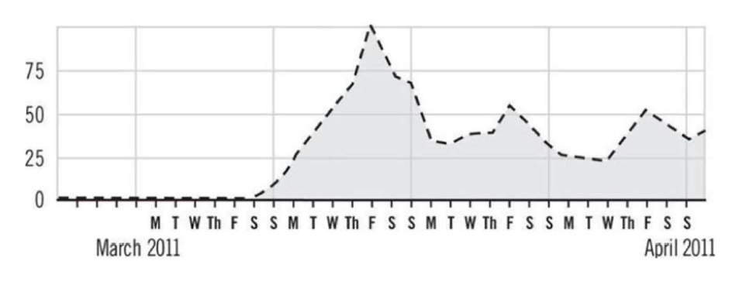
SEARCHES FOR REBECCA BLACK ON YOUTUBE
What do you notice about the SPIKES?
Notes:
Triggers have a big impact on human behavior. They shape the choices we make, the things we talk about, and the products we buy.
Playing French music at the grocery store makes people more likely to buy French wine, and playing German music makes people more likely to buy German wine.
An example of a trigger at work happened in 1997 when NASA’s Pathfinder spacecraft landed on Mars. More people bought the Mars chocolate bar because the planet Mars was mentioned more often by news organizations.
Negative feedback can be good publicity as every feedback acts as a trigger that reminds people that your product exists.

Slide 9
EMOTIONS
“The more we care about a piece of information or the more we're feeling physiologically aroused, the more likely we pass something on.”
When we care, we share.
So how can we craft messages and ideas that make people feel something?
Naturally contagious content usually evokes some sort of emotion.

Slide 10
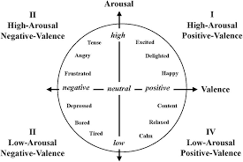
Notes:
Emotional valence describes the extent to which an emotion is positive or negative.
Arousal refers to its intensity of the emotion.
A potential tax hike is infuriating.
Emotional things often get shared. So rather than harping on function, we need to focus on feelings.
Some emotions increase sharing, while others actually decrease it. So we need to pick the right emotions to evoke. We need to kindle the fire. Sometimes even negative emotions may be useful.
Rather than features or facts, we need to focus on feelings, the feelings that motivate people to action.

Slide 11
PUBLIC
“We need to design products and initiatives that
advertise themselves and create behavioral residue that sticks around even after
people have bought the product or espoused the idea.”
Can people see when others are using our product or engaging in our desired behavior?
The famous phrase “Monkey see, monkey do” captures more than just the human tendency to imitate.
People imitate those around them. They do so because other people’s choices provide information and help solve uncertainty. This phenomenon is called social proof.
Notes:
Examples: Jerusalema, Chikibombe
Behavior is public and thoughts are private.
It’s been said that when people are free to do as they please, they usually imitate one another.

Slide 12
PRACTICAL VALUE
“We need to understand what makes something seem like a particularly good deal. We need to highlight
the incredible value of what we offer—monetarily and otherwise.”
How can we craft content that seems useful?
People like to help others, so if we can show them how our products or ideas will save time, improve health, or save money, they’ll spread the word.
Notes:
Examples: Jerusalema, Chikibombe

Slide 13
PRACTICAL VALUE: HOW TO ACHIEVE IT?
1. Saving a couple of bucks
2. Highlighting incredible value
3. Help people achieve goals
Notes:
1. When most people think about practical value, saving money is one of the first things that comes to mind—getting something for less than its original price or
getting more of something than you usually would for the same price.
One of the main tenets of prospect theory is that people don’t evaluate things in absolute terms. They evaluate them relative to a comparison standard, or “reference point.”
2. Deals seem more appealing when they highlight incredible value. As discussed in the Social Currency chapter, the more remarkable something is, the more likely it will be discussed.
If the product’s price is less than $100, the Rule of 100 says that percentage discounts will seem larger. For a $30 T-shirt or a $15 entrée, even a $3 discount is still a relatively small number. But percentagewise (10 percent or 20 percent), that same discount looks much bigger.
Shapes, sounds and a host of other distinctive characteristics can also help products advertise themselves.

Slide 14
STORIES
“Narratives are inherently more engrossing than basic facts. They have a beginning, middle, and end. If people get sucked in early, they’ll stay for the conclusion.”
People don’t just share information, they tell stories.
Stories make it easier to share information. They even make lessons more relatable.
Stories are the original form of entertainment.
Notes:
People are so used to telling stories that they create narratives even when they don’t actually need to. Take online reviews.
A 5 star book review on Amazon for example leads to about 20 more books being sold. More offline reviews about a restaurant leads to about a $200 increase in sales.
People are also less likely to argue against stories as opposed to advertising claims.

