Slide 1
Welcome to the Eaglelite Book Club

Slide 2
Meeting Plan
Welcome -Moderator
Introductions (optional)
About the Book Club
Book review- 40mins (20 each)
Reflections and reactions (20mins)
About Eaglelite Associates

Slide 3
About the Book Club
Will be part of a team that will be supported to improve their reading culture through peer mentorship
Gain access and membership to our library partner who has access to wider range of books (future)
Get opportunities to lead book reviews or share learnings with the larger network of people from various professions
Have guaranteed slots in organized book review meetings with associated benefits
Deep dive sessions where dig deeper into the book.
Will be meeting every third Saturday of every month

Slide 4
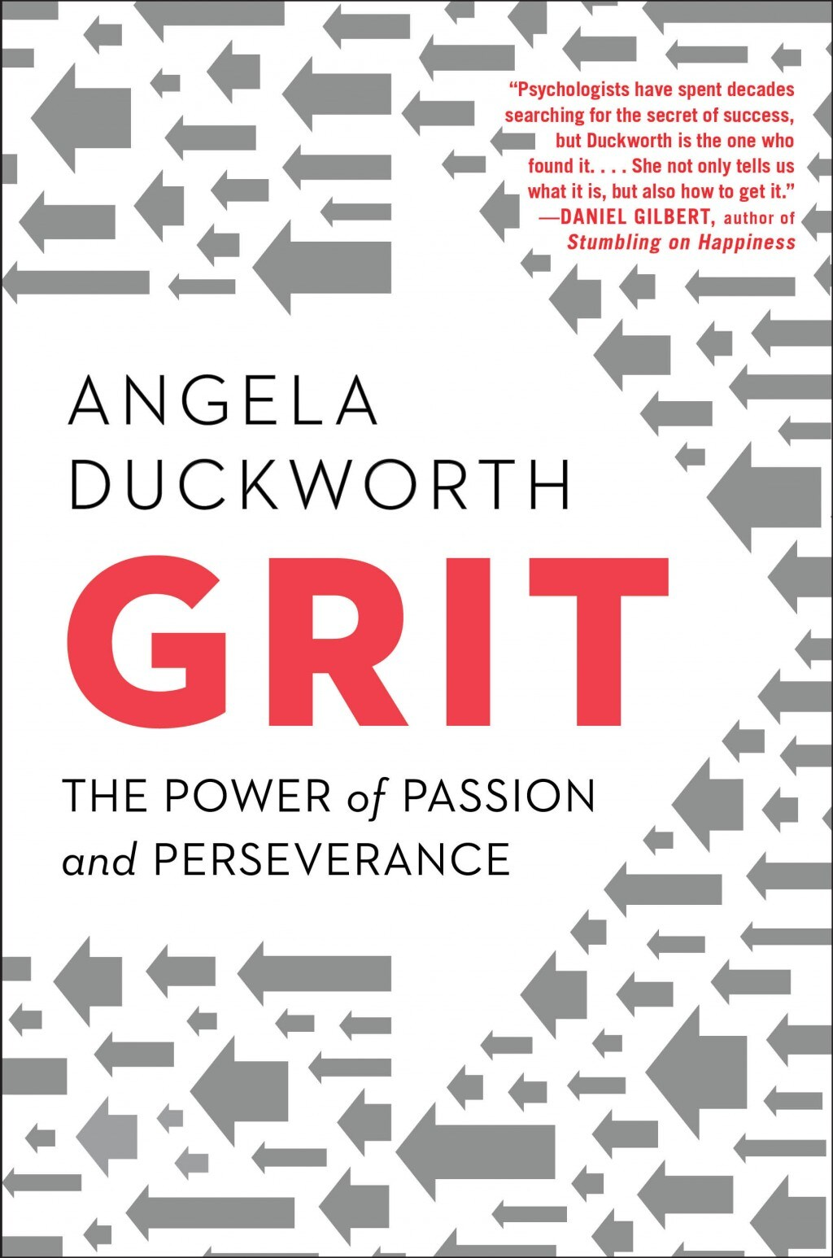
Book Review
By Allan Kakinda & Brenda Abeja

Slide 5
About the book and author
Genre: Self-Help
Release Date: May 3, 2016
Pages: 352
Author: Angela Duckworth is a psychology researcher, Oxford and Harvard alumni and psychology teacher at the University of Pennsylvania. She became popular because of her research on grit, perseverance and achievement for which she also won a McArthur award.

Slide 6
Introduction
Grit is the combination of passion and perseverance for long-term goals.
One way to think about grit is to consider what grit isn’t.
Grit isn’t talent. Grit isn’t luck. Grit isn’t how intensely, for the moment, you want something.
Instead, grit is about having what some researchers call an “ultimate concern”–a goal you care about so much that it organizes and gives meaning to almost everything you do. And grit is holding steadfast to that goal. Even when you fall down. Even when you screw up. Even when progress toward that goal is halting or slow.
Talent and luck matter to success. But talent and luck are no guarantee of grit. And in the very long run, I think grit may matter as least as much, if not more.

Slide 7
Book Chapters
Part I: What Grit Is And Why It Matters
Chapter 1: Showing Up
Chapter 2: Distracted By Talent
Chapter 3: Effort Counts Twice
Chapter 4: How Gritty Are You
Chapter 5: Grit Grows
Part II Growing Grit From The Inside Out
Chapter 6: Interest
Chapter 7: Practice
Chapter 8: Purpose
Chapter 9: Hope
Part III – Growing Grit From Outside In
Chapter 10: Parenting For Grit
Chapter 11: The Playing Fields Of Grit
Chapter 12: A Culture Of Grit
Chapter 13: Conclusion

Slide 8
How GRIT Grows
Interest: “Passion for your work is a little bit of discovery, followed by a lot of development, and then a lifetime of deepening.” Angela Duckworth – Grit
Practice: “We all know people who had tremendous talent who didn’t do anything with it.”
Purpose: is a final answer to the question “Why? Why are you doing this?” In “grit lexicon,” purpose means “the intention to contribute to the well-being of others.”
Hope: Grit rests on the expectation that our own efforts can improve our future. “I have a feeling tomorrow will be better” is different from “I resolve to make tomorrow better.” Hope for Gritty people has nothing to do with luck and everything to do with getting up again.

Slide 9
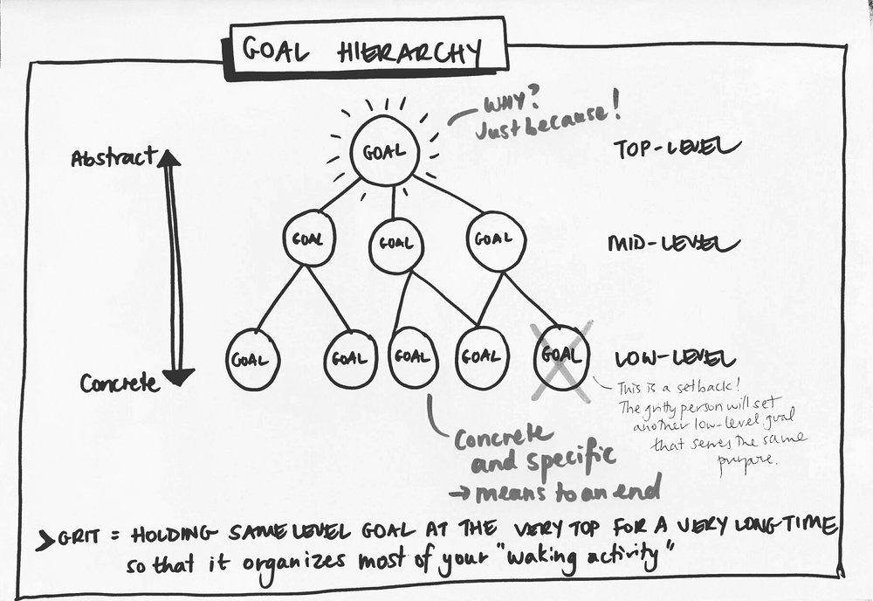

Slide 10
Polls
Run poll on Zoom

Slide 11
Showing up and Follow through
Let me speculate, though. Left to her own devices, a little girl who, after failing to open a box of raisins and saying to herself, “This is too hard! I quit!” might enter a vicious cycle that reinforces giving up. She might learn to give up one thing after another, each time missing the opportunity to enter the virtuous cycle of struggle, followed by progress, followed by confidence to try something even harder.
Notes:
But what about a little girl whose mother takes her to ballet, even though it’s hard? Even though the little girl doesn’t really feel like putting on her leotard at that moment, because she’s a little tired. Even though, at the last practice, her ballet teacher scolded her for holding her arms the wrong way, which clearly stung a bit. What if that little girl was nudged to try and try again and, at one practice, experienced the satisfaction of a breakthrough? Might that victory encourage the little girl to practice other difficult things? Might she learn to welcome challenge?

Slide 12
PRACTICE
“We all know people who had tremendous talent who didn’t do anything with it,”

Slide 13
Spelling Bee Champions
Champions prepared in three ways —
They read a lot, and it was effortless and enjoyable.
Kids would get quizzed by mom and dad, teachers, etc.
And finally, they would put in deliberate practice. This would be done alone where they would study word origins, respell words, and work on their weaknesses.

Slide 14
Swimming’s greatest ambassador, 3-time Olympic Gold Medalist, one the great American sprint freestylers of all-time,five-time NCAA Champion

Slide 15
Interview with Rowdy Gaines
Swam, in increments of fifty-yard laps, at least 20,000 miles in order to develop stamina, technique, confidence and judgement to win an Olympic gold medal.
R: I swam around the world for a race that lasted 49 seconds.
A: Do you enjoy those miles? I mean did you love practicing?
R: I am not going to lie. I never really enjoyed going to practice, and I certainly didn’t enjoy it while I was there. In fact, there were brief moments, walking to the pool at 4/4:30am or sometimes when I couldn’t take the pain, when I’d think, ‘God, is it worth it?’
A: So why didn’t you quit?
R: Its very simple. Its b’se I loved swimming… i had a passion for competing, for the result of the training, for the feeling of being in shape, for winning, for travelling, for meeting friends. I hated practice but i had an overall passion for swimming.

Slide 16
The Science of Deliberate Practice
A clearly defined stretch goal
Full concentration and effort
Immediate and informative feedback
Repetition with reflection and refinement
“deliberate practice,” begins with a “stretch goal,” a 100% focus on attaining that goal, getting feedback, and then reflecting on that feedback and refining one’s practice as needed.

Slide 17
Deliberate Practice in Action
Create a deliberate practice plan.
Set stretch goals that ever increasing
It’s research. It’s testing. It’s learning.
Don’t take the discomfort so serious

Slide 18
INTERESTING AND HARD
But what about grit? What about accomplishing something that takes years, as opposed to months, of work? If grit is about sticking with a goal for the long-term, and if extracurricular activities are a way of practicing grit, it stands to reason that they’re especially beneficial when we do them for more than a year.
The bottom line of this research is this: School’s hard, but for many kids it’s not intrinsically interesting. Texting your friends is interesting, but it’s not hard. But ballet? Ballet can be both.
Notes:
Learning to follow through on something hard in high school seems to be the best-possible preparation for doing the same thing later in life.
Extracurricular activities are a way for young people to practice, and therefore develop passion and perseverance, for long-term goals.

Slide 19
Everyone has to do a hard thing. A hard thing is something that requires daily deliberate practice.
You can quit but not on a bad day. You can’t quit until the season is over, the tuition payment is up, or some other “natural” stopping point has arrived. You must, at least for the interval to which you’ve committed yourself, finish whatever you begin. In other words, you can’t quit on a day when your teacher yells at you, or you lose a race, or you have to miss a sleepover because of a recital the next morning.
You get to pick your hard thing. Nobody picks it for you because, after all, it would make no sense to do a hard thing you’re not even vaguely interested in
Recommended by Duckworth for the entire family

